Slide 1
Office Escape
Group:
Gary Anderson
Paul Young
Levi Boylan

Slide 2
Our Game concept
Puzzle/Maze style game
Stuck in boring office job
Must quietly escape using your office chair
Avoid your bosses as you traverse the maze like office layout
Level completion when you reach the exit undetected
Multiple levels with varying difficulty

Slide 3
Gameplay
Must manoeuvre through levels to reach the goal
Numerous obstacles such as drawers and cubicle walls
Must avoid touching hazards and making too much noise
If a boss catches you, you will fail the level
Easy to pick up and play

Slide 4
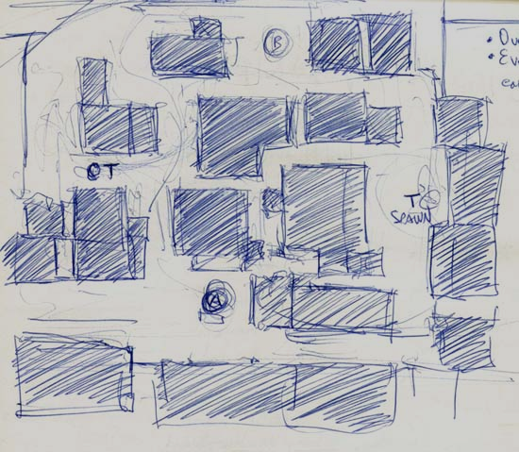
Level Design
Level pathways laid out using office cubicles
Alternative ways to reach level goal
Managers follow preset route allowing players to plan ahead
Short, quickfire levels with slight variation in each
As levels are completed, the difficulty increases with timing and accurate controlling becoming essential
Various objects around the map

Slide 5
Level Layout
Add image

Slide 6
Video

Slide 7
Thank you!

